Slide 1
11 Handling Subresources

Slide 2
@Path Annotation
@Path annotation is used for the identification of the resource that is to be called for the specific request.
@Path annotation can be defined at the following two levels:
Class-level
method-level (within the class)
Class-level @Path annotation is termed as the root resource class, and the methods are defined as resource methods
Method-level @Path annotation points directly to a specific method under the root resource class, which is defined as subresource method

Slide 3
@Path Annotation
@Path("/userService")
public class UserResource
{
@GET
public String getUser()
{
return "John";
}
@GET
@Path("/getUserName")
public String getUserName()
{
return "John";
}
}
/userService is the root resource path
getUserName() is a subresource method
We explicitly defined the path of the method
http://localhost:8080/services/userService
the first resource method, getUser(), will be invoked
http://localhost:8080/services/userService/getUserName
getUserName() method will be invoked
/getUserName is the subresource that will invoke getUserName() method
Subresource method handles the HTTP request directly

Slide 4
@Path Annotation
Resource methods have a @Path annotation, but no HTTP method are called subresource locators
E.g. a method under the root resource class that is not annotated by GET HTTP header (@GET )
The purpose of a sub-resource locator is to provide an object of the subresource class that can process the HTTP request.
It helps in easier management of the code, and each subresource will be loosely coupled

Slide 5
Subresource Method vs Subresource Locator
Subresource Locator: obtains the subresource Employee from the path /employeeinfo/employees/{fullName}
@Path("/employeeinfo")
public class EmployeeInfoResource
{
@Path(“/employees/{fullName}”)
public Employee getEmployee(@PathParam(“fullName”) String fullName) {
Employee emp = new Employee(fullName);
return emp;
}
@GET
@Path("/empoyees")
public String getAllEmployees()
{
return “List of employees from sub resource method”
}
}
Subresource Method that handles directly the HTTP GET request

Slide 6
Subresource Method vs Subresource Locator
public class Employee
{
private String fullName;
public Employee (String fullName) {
this.fullName=fullName;
}
@GET
@Path("/firstname")
public String getEmployeeFirstName() {
return fullName.substring (0, fulName.indexOf(“ “));
}
@GET
@Path("/lastname")
public String getEmployeeLastName() {
return fullName.substring (fulName.indexOf(“ “)+1);
}
}
Subresource Class
Subresource Method: returns the employee’s first name
Subresource Method: returns the employee’s last name

Slide 7
Subresource Method vs Subresource Locator
Request URL
http://localhost:8080/TestService/employeeinfo/employees
Output: List of employees from sub resource method
Request URL
http://localhost:8080/TestService/employeeinfo/employees/John Doe/firstname
Output: John
Request URL
http://localhost:8080/TestService/employeeinfo/employees/John Doe/lastname
Output: Doe

Slide 8
Examples of Apps using Subresources
Online Books Store API
The app allows a client to access books for sale and get different information
A “book” might have one or multiple “reviews”, therefore in a REST API we need resource names like below in order to interact with these resources
http://localhost:49000/api/books/{bookId}/reviews/{reviewID}
Online Chinese takeaway API
An application that allows a customer to order online various Chinese meals
A “order” might have one or multiple “foodItems”, therefore in a REST API we need resource names like below in order to interact with these resources
http://localhost:49000/api/orders/{orderId}/fooditems/{fooditemID}

Slide 9
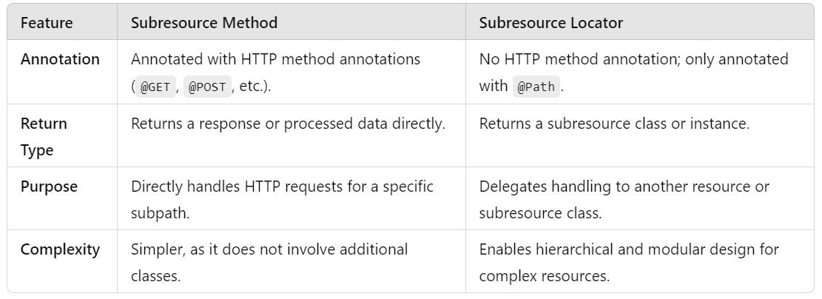
Key Difference

Slide 10
Examples of Apps using Subresources
MyBlog API – We extend the functionality so that…
A “message” contains none or several “comments”. In the REST API we need resource names like below to interact with these resources http://localhost:49000/api/messages/{messageId}/comments/{commentID}
Users can see all the posted messages as well as comments posted to a specific message.
Users can post a message and a comment.

Slide 11
Contained vs Delegated Implementation of Services
Delegated implementation
It implies we will be delegating the handling of subresources to their corresponding Java class or classes (Models, Services, Resources).
We have several Java classes for resources and subresources.
This is a recommended and elegant way to code when designing and implementing subresources within APIs.
Contained implementation
Consists of handling ALL resources + subresources within one single Java class.
It is used with simple designs and where there is no future complexity and scalability considered.

Slide 12
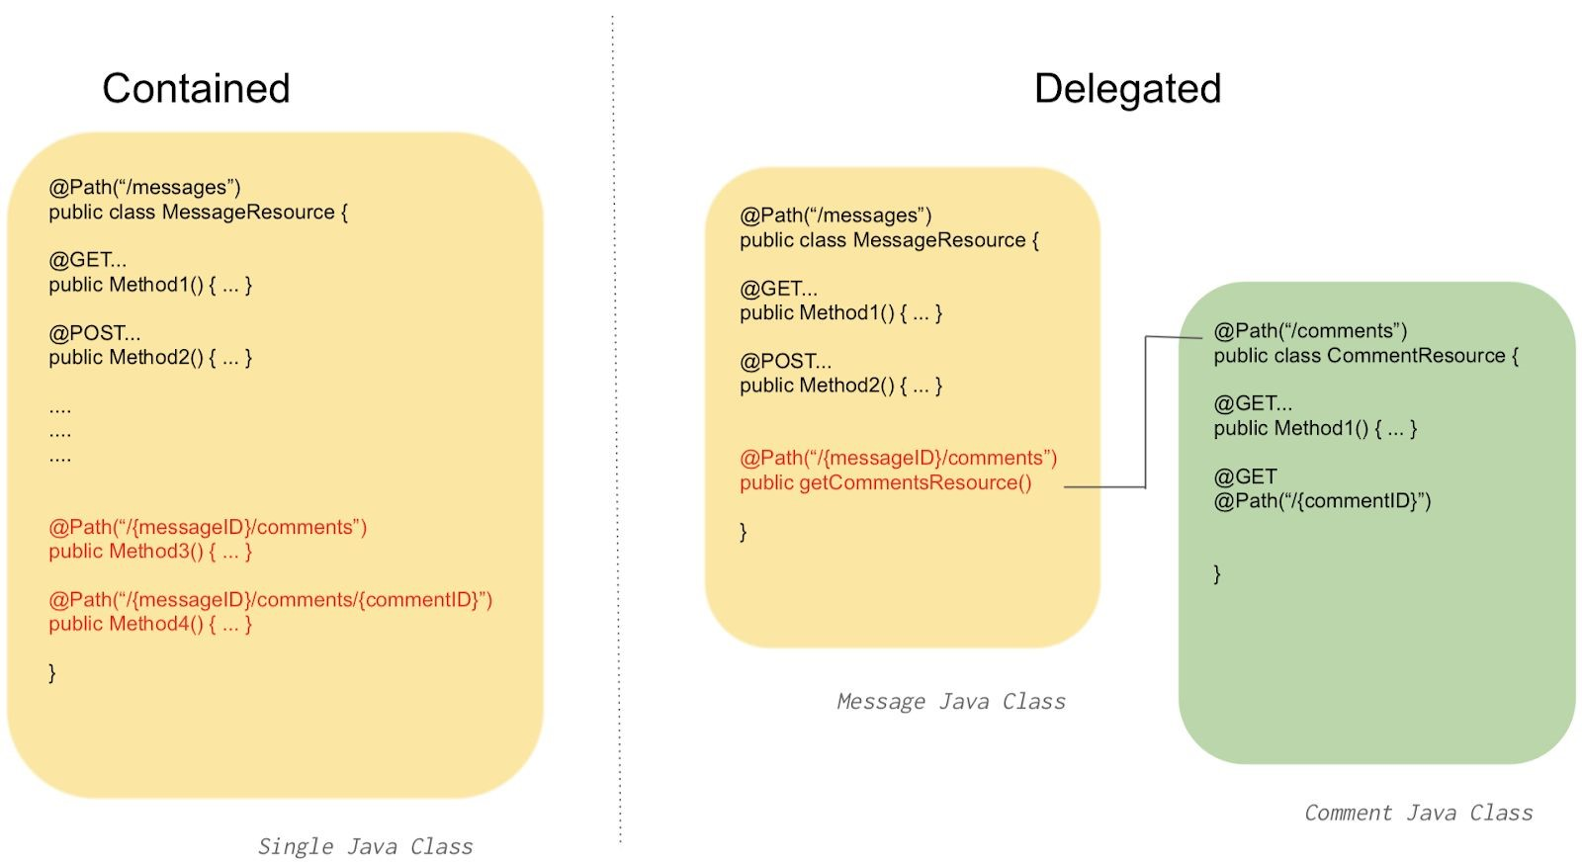
Contained vs Delegated Implementation of Services

Slide 13
MyBlogs API – Delegated Implementation
1) First, extend the MyBlog API developed last week to be able to manage comments posted to each message.
Extend Message.java class to have a list of comments as class member and add get and set methods
public class Message {
private int id;
private String message;
private Date created;
private String author;
private List<Comment> comments;
public Message(int id, String message, String author, List<Comment> comments ) {
this.id = id;
this.message = message;
this.created = new Date();
this.author = author;
this.comments = comments;
}
. . .
}

Slide 14
MyBlogs API – Delegated Implementation
2) Need to modify the current MessageResource.java class to ​delegate​ all request calls to a NEW set of Java classes defined for the ​comments subresource.
3) In MessageResource.java - Need to redirect all incoming requests to our REST API which contains the string “comments” in the URL to a new subresource class, by using the Jersey annotations
@Path(“/{messageID}/comments”) or @Path(“/{messageID}/comments/{commentID}).
@Path("/{messageID}/comments")
public CommentResource getCommentsResource() {
System.out.println("Getting comments subresoruces...");
return new CommentResource();
}

Slide 15
MyBlogs API – Delegated Implementation
4) These requests need to be managed and mapped now under a new class called CommentResource.java. We can reuse much of the code we did when we created the class MessageResource.java for the “messages” resources.
Remember that the Resources layer contains the Jersey annotations or mappings to our Services in the SOC.
The new subresource class (CommentResource.java) supports the Jersey annotation and maps specific application functionality for two methods:
List ALL comments for a specific {messageID}
list a specific {commentID} for a specific {messageID}.

Slide 16
MyBlogs API – Delegated Implementation
@Path("/comments")
@Consumes(MediaType.APPLICATION_JSON)
@Produces(MediaType.APPLICATION_JSON)
public class CommentResource {
private CommentService CommentService = new CommentService();
@GET
public List<Comment> getComments(@PathParam("messageID") int m_id) {
System.out.println("getAllCommentsForMessage..."+m_id);
return CommentService. getAllCommentsByMessage(m_id) ();
}
@GET
@Path("/{commentID}")
public Comment getComment(@PathParam("commentID") int c_id, @PathParam("messageID") int m_id ) {
System.out.println("getCommentByID..."+c_id);
return CommentService. getCommentByID(m_id, c_id);
}

Slide 17
MyBlogs API – Delegated Implementation
5) We will also create the needed classes (specific to comments) under the Services and Models packages like we did with the message
CommentService.java and Comment.java
public class Comment {
private int id;
private String comment;
public Comment(int id, String comment) {
this.id = id;
this.comment = comment;
}
//get and set methods
}

Slide 18
MyBlogs API – Delegated Implementation
public class CommentService
{
public static List<Message> mlist = new ArrayList<>();
public static List<Comment> clist = new ArrayList<>();
// class constructors here
public List<Comment> getAllComments() {
return clist;
}
public List<Comment> getAllCommentsByMessage(int MessageID) {
return mlist.get(MessageID-1).getComments();
}
public Comment getCommentByID(int MessageID, int CommentID) {
return mlist.get(MessageID-1).getComments().get(CommentID-1);
}
}
Provides 2 functionalities :
- retrieves ALL ​comments​ for a specific ​messageID​ ;
- retrieves a specific comment given a ​commentID​ for a specific ​messageID​.

Slide 19
MyBlogs API – Step by Step Implementation Instructions
Start the implementation of these new features following the guidelines provided in Lab – Handling Subresources
We will continue to work on the implementation in the lab session.

Slide 20
MyBlogs API – SoC: Database layer
6) Create a SOC Database stub layer
Our current API solution implements in-memory storage with ArrayLists embedded in the respective Service Java class (e.g. MessageService.java) contained in the Services SOC package
A much better design will separate the Database into another layer within the SOC.
7) Create a new SOC class package called Databases to hold all in-memory “mock” database structures and remove the stubs from the current java classes

Slide 21
MyBlogs API – Delegated Implementation
public class Database {
public static List<Message> messageDB = new ArrayList<>();
public static List<Comment> commentDB = new ArrayList<>();
public static boolean init = true;
public Database () {
if(init) {
Comment c1 = new Comment (1,"One comment");
Comment c2 = new Comment (2,"Another comment");
commentDB.add(c1);
commentDB.add(c2);
Message m1 = new Message(1,"First", "Manuel", commentDB);
messageDB.add(m1);
init = false;
}
}
public static List<Message> getMessagesDB() {
return messageDB;
}
public static List<Comment> getCommentsDB() {
return commentDB;
}

Slide 22
MyBlogs API – SoC: Database layer
8) Modify CommentService.java class to remove the databases coded here and create Database object. Retrieve the MessagesDB and CommentsDB from the Database object.

Slide 23
MyBlogs API – SoC: Database layer
public class CommentService
{
private List<Message> mlist = new Database().getMessagesDB();
private List<Comment> clist = new Database().getCommentsDB();
public List<Comment> getAllComments() {
return clist;
}
public List<Comment> getAllCommentsByMessage(int MessageID) {
return mlist.get(MessageID-1).getComments();
}
public Comment getCommentByID(int MessageID, int CommentID) {
return list.get(MessageID-1).getComments().get(CommentID-1);
}
}
Provides 2 functionalities :
- retrieves ALL ​comments​ for a specific ​messageID​ ;
- retrieves a specific comment given a ​commentID​ for a specific ​messageID​.

Slide 24
MyBlogs API – SoC: Database layer
public class MessageService {
Database d = new Database();
private List<Message> list = d.getMessagesDB();
public List<Message> getAllMessages() {
return list;
}
. . .
}

Slide 25
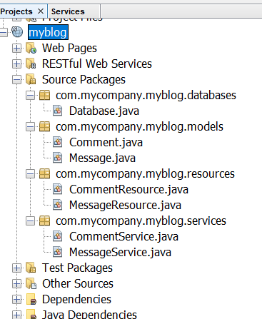
MyBlogs API – Updated Structure
MyBlog API will have four SOC packages - models, services, resources and databases

Slide 26
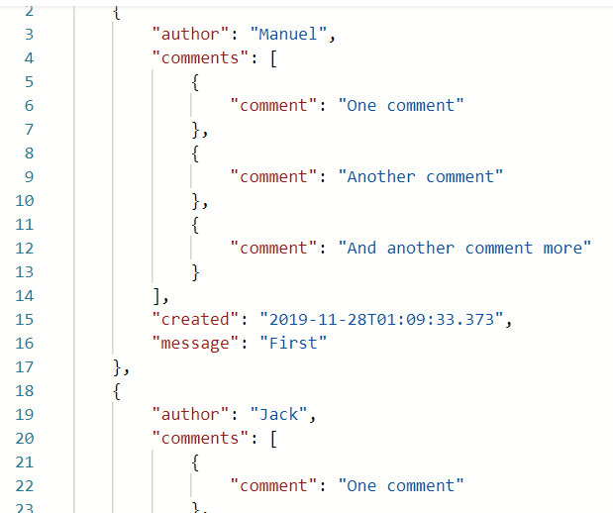
MyBlog Output
URL: localhost:49000/api/messages
Output:

Slide 27
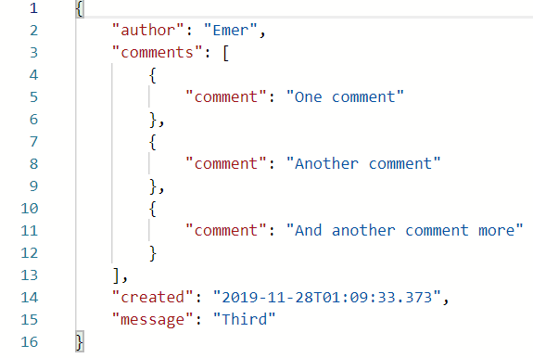
MyBlog Output
URL: localhost:49000/api/messages/3
Output:

Slide 28
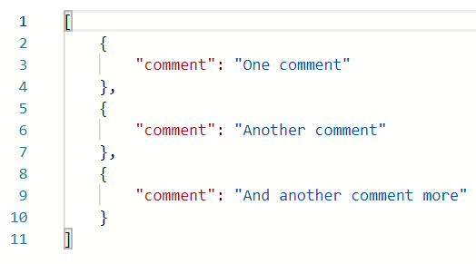
MyBlog Output
URL: localhost:49000/api/messages/3/comments
Output:

Slide 29

MyBlog Output
URL: localhost:49000/api/messages/3/comments/2
Output:

